Slide 1
ME759 High Performance Computing for Applications in Engineering [Spring 2021]
Lecture 08
02/10/2021
Dan Negrut, 2021 ME759 UW-Madison

Slide 2

Cartoon of the day
[Joe Dator]$→$

Slide 3
Is BBC recording on?
If my internet connection goes down, I’ll email from my phone to provide more information – go/no-go, next step, etc.

Slide 4
Before we get started…
Last time
Wrap up Virtual memory discussion
Discuss why folks started to look into parallel computing
The three walls: memory, power, ILP
Moore’s law, and implications
Today
Flynn’s Taxonomy
Amdahl's Law
Start GPU computing: discussion of hardware aspects
Other tidbits:
Assignment due on Th, 02/11, at 9 pm
Do not run your code on the Euler headnode (use Slurm)
Please read the ME459 “elements of C” material if malloc/new & pointers are not your friends

Slide 5
Transistors bonanza: bringing happiness in lots of corners
Ability to cram more transistors per unit area and still make a profit good in many respects
Microprocessors
Memory capacity & speed
Storage controllers

Slide 6
Parallel computing: The Ox vs. Chickens Analogy
“If you were plowing a field, which would you rather use: Two strong oxen or 1024 chickens?” [Seymour Cray$→$]
Ox: one powerful CPU core, running at high frequency, lots of cache to hide memory latency
Chicken: many meagre processors, running at lower frequency, not much cache or brain (like in CU)
Requires other ways to hide memory latency
Few were eating chicken a decade ago but popular now

Slide 7
Two examples of Parallel HW: Putting to good use billions of transistors
Intel Haswell
Multicore architecture
Four oxen, that is
NVIDIA Fermi
Large number of scalar processors (“shaders”)
512 chicken, that is

Slide 8
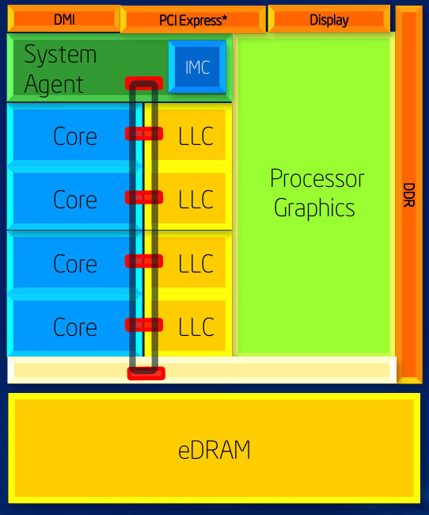
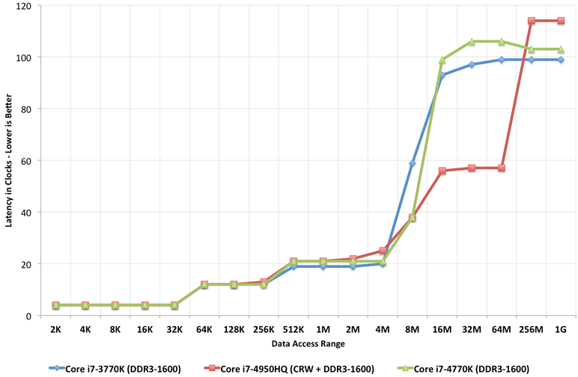
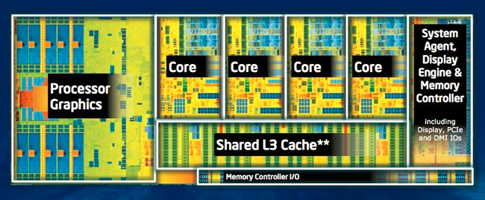
Intel Haswell
June 2013
22 nm technology
1.4 billion transistors
4 cores, HTT
Integrated GPU
System-on-a-chip (SoC) design
Notes:
Direct Media Interface (DMI) is the link between the northbridge and southbridge on a computer motherboard

Slide 9
Haswell example: multi-core architecture (four oxen)
Shared-Memory Multiprocessor Architecture
SRAM
SRAM
DRAM
Courtesy of Elsevier, Computer Architecture, Hennessey and Patterson, fifth edition
Notes:
Hammad – Updated Figure from fifth edition

Slide 10
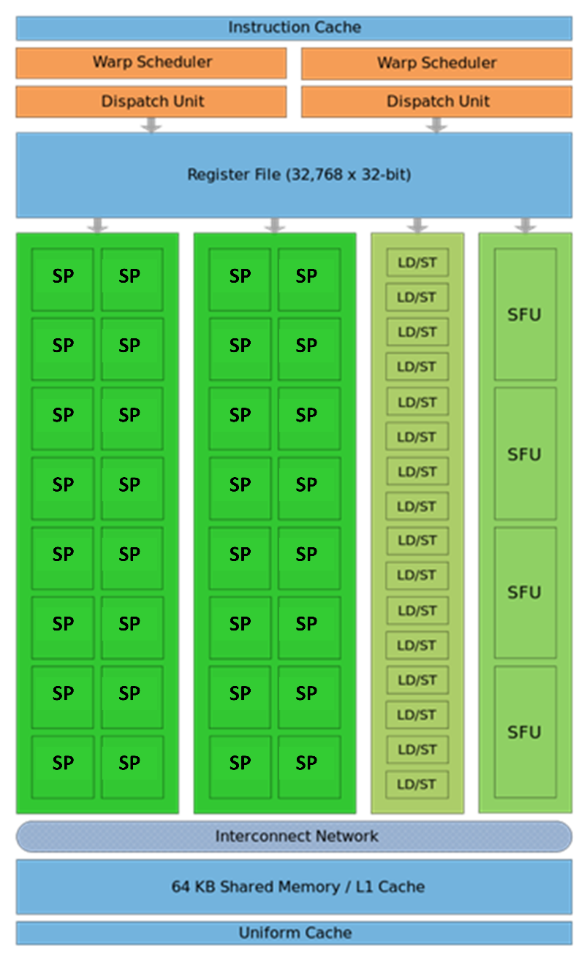
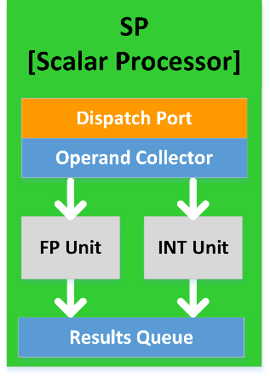
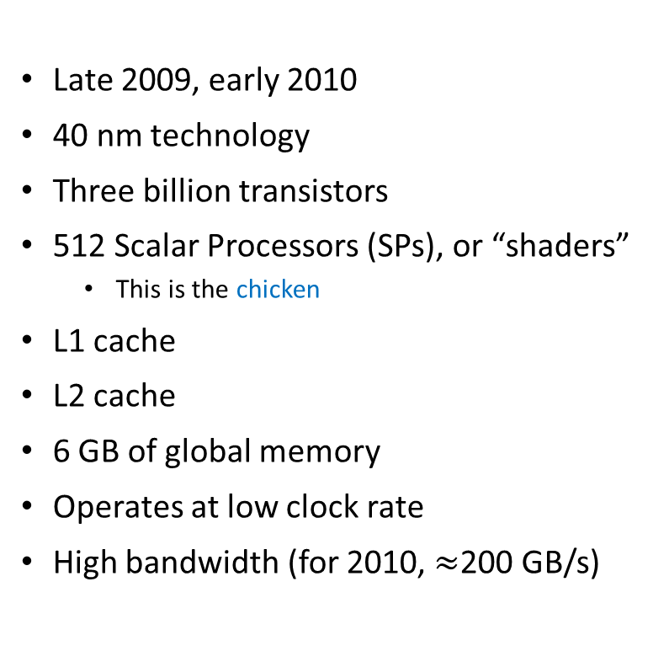
The Fermi Architecture [ Schematic of a NVIDIA Stream Multiprocessor (SM)]
Late 2009, early 2010
40 nm technology
Three billion transistors
512 Scalar Processors (SPs), or “shaders”
This is the chicken
L1 cache
L2 cache
6 GB of global memory
Operates at low clock rate
High bandwidth (for 2010, $≈$200 GB/s)

Slide 11
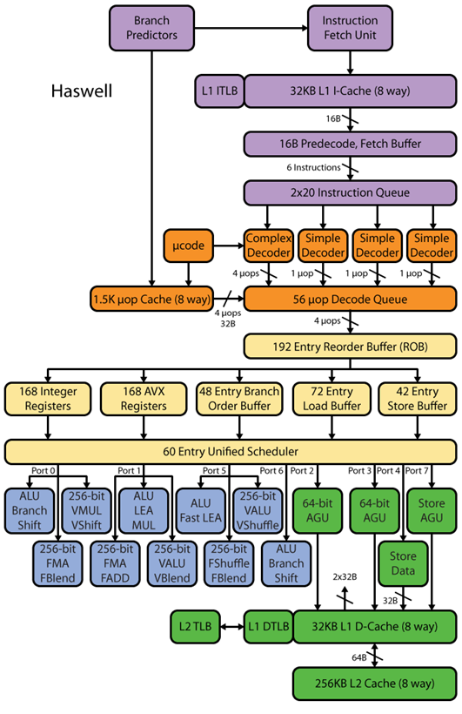
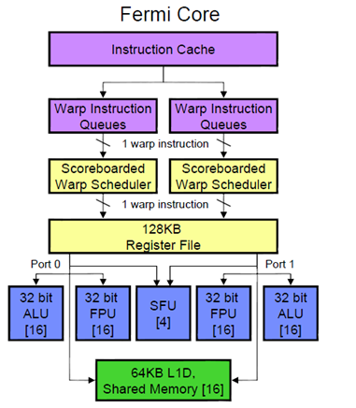
A Fermi SM (Streaming Multiprocessor; one of 16)
Not a whole lot of brain here, compared to CPU.

Slide 12
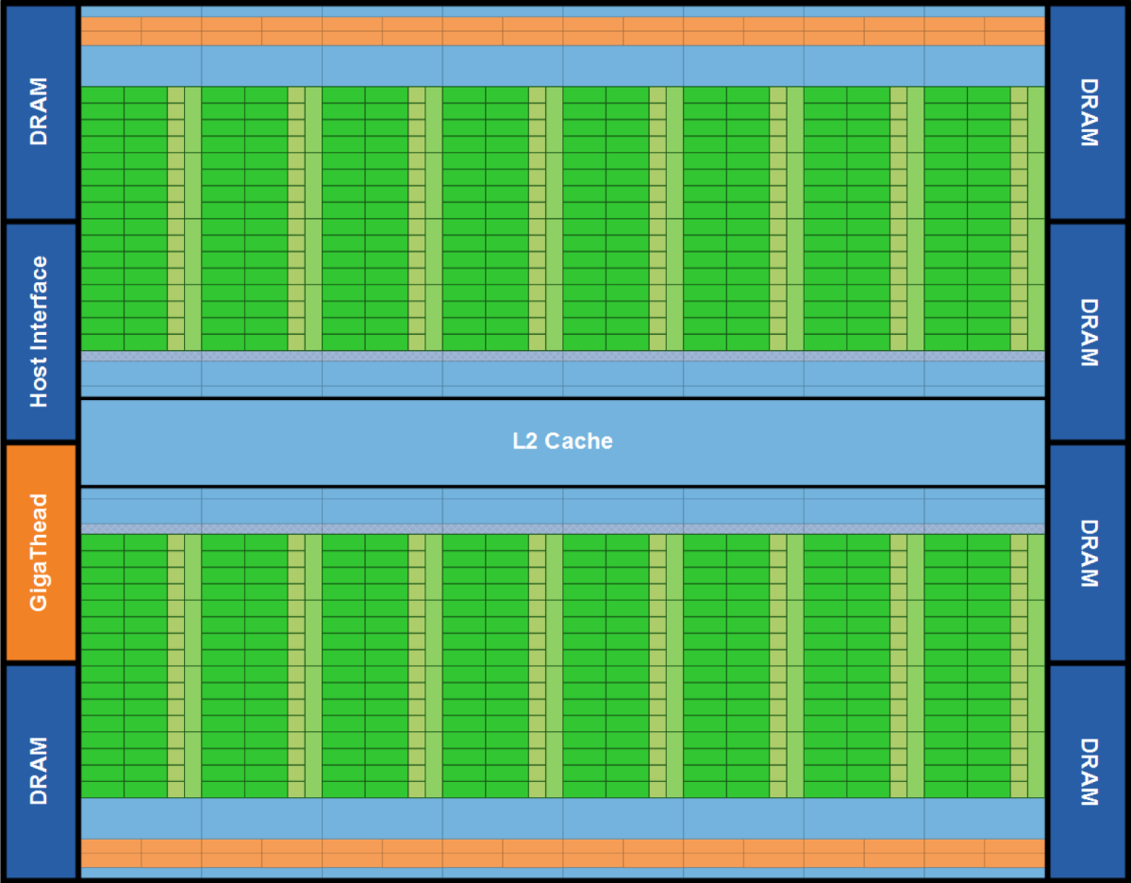
Fermi: 30,000 feet perspective, the entire chip
Lots of ALU (green), not much of CU (orange)
Explains why GPUs are fast for high arithmetic intensity applications
Arithmetic intensity: high when many operations performed per byte of data

Slide 13
The CPU and GPU: showing their true colors
The GPU is specialized for compute-intensive, highly data parallel computation (owing to its graphics rendering origin)
More transistors devoted to data processing rather than data caching and control flow
Where are GPUs good: high arithmetic intensity (the ratio between arithmetic operations and memory operations)
The video game industry exerts strong economic pressure that pushes things forward in GPU computing
Control
ALU
ALU
ALU
ALU
CPU
GPU
Cache
DRAM
DRAM

Slide 14
Beefy CPU vs. beefy GPU comparison, 2021
 | GPU – NVIDIA Tesla A100 40 GB $9895 | CPU – Intel® Xeon® Platinum 9282 (about $20K? – can’t find a price)
Processing Cores | 6912 CUDA Scalar Processors 432 Tensor Cores | 56 cores (112 threads, SMT)
Memory (apples vs. oranges) | 40GB HBM2 | - 32+32 KB L1 (I+D) cache / core (8-way assoc.) - 1 MB L2 cache / core (16-way assoc.) - 77 MB L3 cache (1.375 MB / core, average)
Clock speed | 1.41 GHz (max) | 2.6 GHz (3.80 GHz Turbo)
Memory bandwidth | 1555 GB/s | 262 GB/s
Floating Point Throughput | 9.7 Double Precision TFLOP/s 19.5 Single Precision TFLOP/s | 3.2 Double Precision TFLOP/s
TDP | 250 Watts | 400 Watts
https://en.wikipedia.org/wiki/Nvidia_Tesla
https://en.wikichip.org/wiki/intel/xeon_platinum/9282

Slide 15
Beefy CPU vs. beefy GPU comparison, 2019
 | GPU – NVIDIA Tesla V100 32GB $8,995 | CPU – Intel® Xeon® Platinum 8180 $10,009
Processing Cores | 5120 CUDA Cores 640 Tensor Cores | 28 cores (56 threads, SMT)
Memory | 32GB HBM2 | - 64 KB L1 (I+D) cache / core - 1 MB L2 cache / core - 38.5 MB L3 cache (1.375 MB / core), average
Clock speed | 1.29 GHz | 2.5 GHz (3.80 GHz Turbo; Throttles to 2.3 GHz when all FP units are active)
Memory bandwidth | 900 GB/s | 119.21 GB/s (19.87 GB / channel / s)
Floating Point Throughput | 7.8 Double Precision TFLOP/s 15.6 Single Precision TFLOP/s | 2.0608 Double Precision TFLOP/s
TDP | 300 Watts | 205 Watts
https://en.wikipedia.org/wiki/Nvidia_Tesla
https://www.techpowerup.com/gpu-specs/tesla-v100-sxm2-32-gb.c3185
https://en.wikichip.org/wiki/intel/xeon_platinum/8180
https://ark.intel.com/products/120496/Intel-Xeon-Platinum-8180-Processor-38-5M-Cache-2-50-GHz-

Slide 16


Other good news: 3D Stacked Memory [looking at other things than just raw increase in transistor count]
Traditional GPU chip$⇔$ GDDR5 memory layout
New GPU (Pascal/Volta/Ampre) chip$⇔$ HBM2 memory layout
Major step forward in performance.

Slide 17
3D Stacked Memory
SK Hynix’s High Bandwidth Memory (HBM)
Developed by AMD and SK Hynix
1st Generation (HBM1) introduced in AMD Fiji GPUs
1GB & 128GB/s per stack
AMD Radeon R9 Fury X: had four stacks → 4GB & 512GB/s
2nd Generation (HBM2) used in NVIDIA Pascal/Volta and AMD Arctic Island GPUs
2 GB & 256GB/s bandwidth per stack
NVIDIA Volta approximately 900 GB/s memory bandwidth
Apparently AMD has 1024 GB/s HBM available
NOTE: There is consistent color code used in both these figures
Notes:
PHY: die-to-die [physical?] interconnect (see https://www.synopsys.com/dw/ipdir.php?ds=dwc_die-to-die_phy)

Slide 18
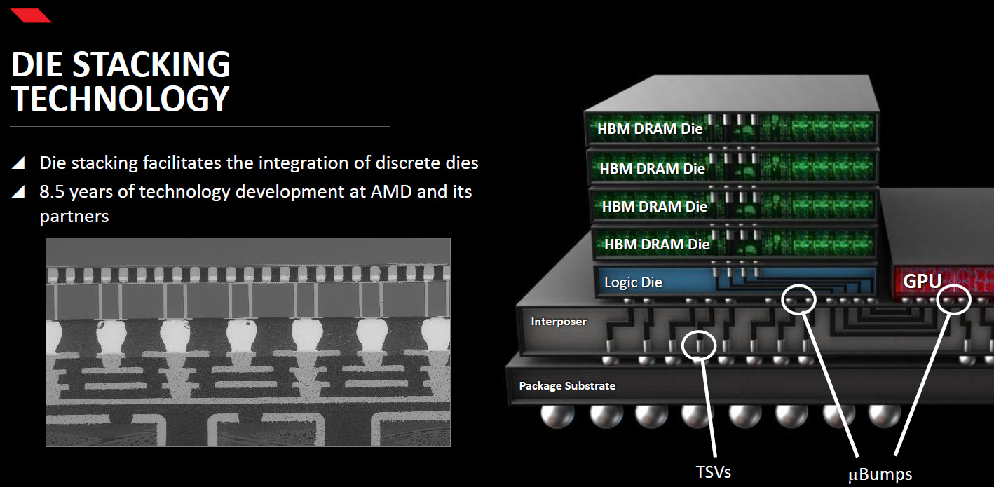
3D Stacked Memory

Slide 19
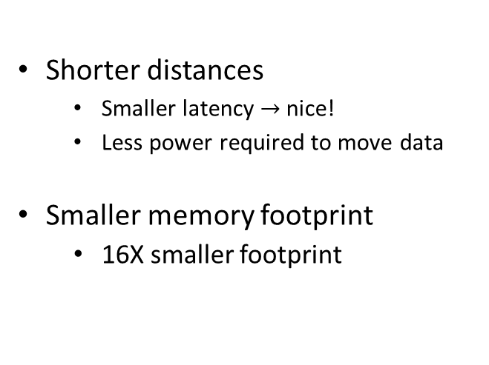
3D Stacked Memory
One HBM stack, made up of four DRAM dies (4-Hi)
Shorter distances
Smaller latency $→$ nice!
Less power required to move data
Smaller memory footprint
16X smaller footprint
Logic die

Slide 20
[side trip, 1/2] on-chip vs. on-package vs. off-package
Where a resource is dictates to a large extent its communication latency and/or bandwidth
Example, on-chip: Intel Haswell has the GPU on the same chip with the rest of the CPU
Example, on-package: the 128 MB of eDRAM available on Intel Core i7 4950HQ
The GPU is on-chip
The eDRAM is on-package

Slide 21


[side trip, 2/2] on-chip vs. on-package vs. off-package
Example, off-package vs. on-package: traditional memory vs. HBM
Off-package Example chip$⇔$ GDDR6 memory
On-package Example chip$⇔$ HBM2 memory

Slide 22
[New Topic] Flynn’s Taxonomy of Architectures [Moving away from hardware; moving into software aspects]
There are several ways to classify architectures
Below, classification based on how instructions are executed in relation to data
SISD - Single Instruction/Single Data
SIMD - Single Instruction/Multiple Data
MISD - Multiple Instruction/Single Data
MIMD - Multiple Instruction/Multiple Data

Slide 23
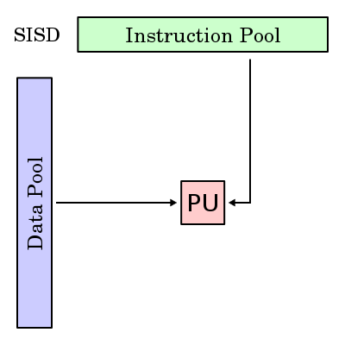

Single Instruction/Single Data (SISD) Architectures
PU – Processing Unit
Your desktop, before the spread of dual core CPUs
[Wikipedia, Flynn’s Taxonomy]$→$
Notes:
PU – Processing Unit

Slide 24

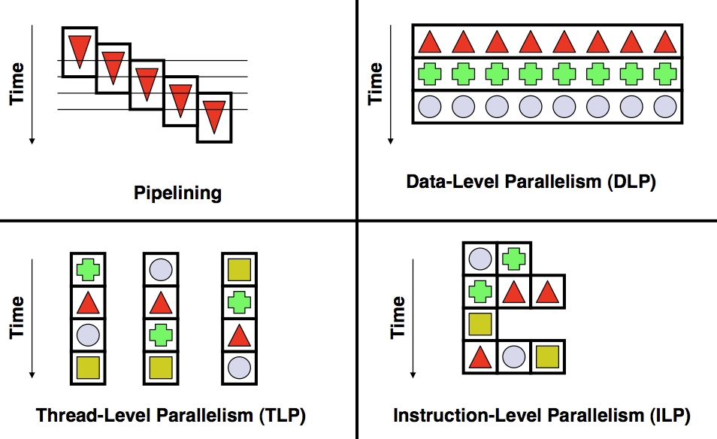
Increasing Throughput of SISD
Instructions:
Time
Time
Pipelining
Multiple Issue
[Wikipedia, Flynn’s Taxonomy]$→$

Slide 25
Single Instruction/Multiple Data (SIMD) Architectures
Processors that execute same instruction on multiple pieces of data: GPUs
[Wikipedia, Flynn’s Taxonomy]$→$
Notes:
Mention also AVX

Slide 26
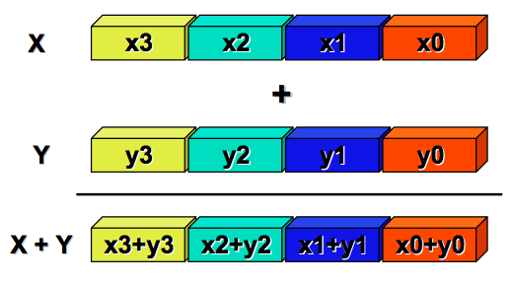

Single Instruction/Multiple Data (SIMD)
Each core runs the same set of instructions on different data
Examples:
Graphics Processing Unit (GPU): processes pixels of an image in parallel
CRAY’s vector processor
[Klimovitski & Macri, Intel]$→$
Notes:
Big data is a major motivator for this type of processing.
Whenever you see lots of data, first consider SIMD

Slide 27

SISD versus SIMD
[Jon Stokes]$→$

Slide 28
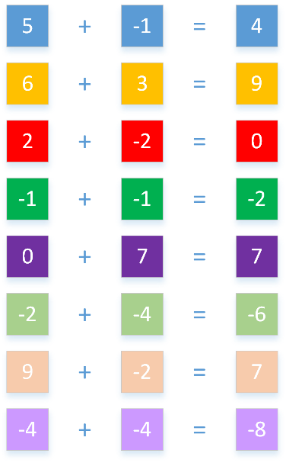
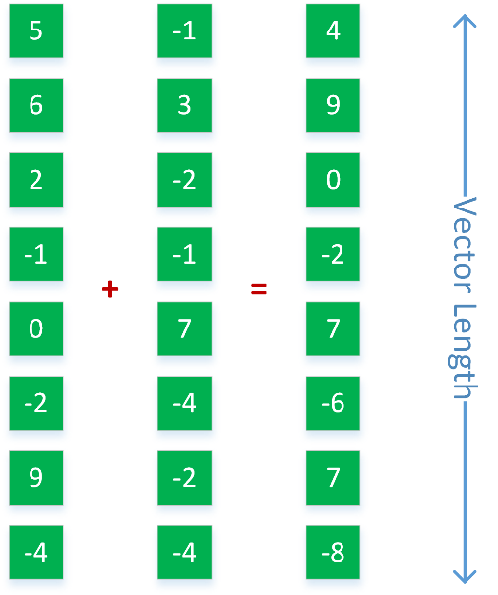
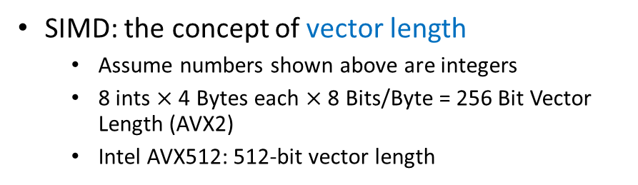
SISD, SIMD, and Vector Length
Accomplishing the same thing
A stream of 8 “SISD” instructions
One SIMD instruction
SIMD: the concept of vector length
Assume numbers shown above are integers
8 ints $×$ 4 Bytes each $×$ 8 Bits/Byte = 256 Bit Vector Length (AVX2)
Intel AVX512: 512-bit vector length

Slide 29
Multiple Instruction/Single Data
Not useful, not aware of any commercial implementation…
[Wikipedia, Flynn’s Taxonomy]$→$

Slide 30
Multiple Instruction/Multiple Data
Almost all our desktop/laptop chips are MIMD systems. Think Intel’s HTT
[Wikipedia, Flynn’s Taxonomy]$→$
Notes:
Most (all?) Top500 supercomputers based on MIMD

Slide 31
Multiple Instruction/Multiple Data
The sky is the limit: each PU is free to do as it pleases
Can be of either shared memory or distributed memory categories
Instructions:
Notes:
Before we move on, a couple of words on difference between HPC and HTC

Slide 32
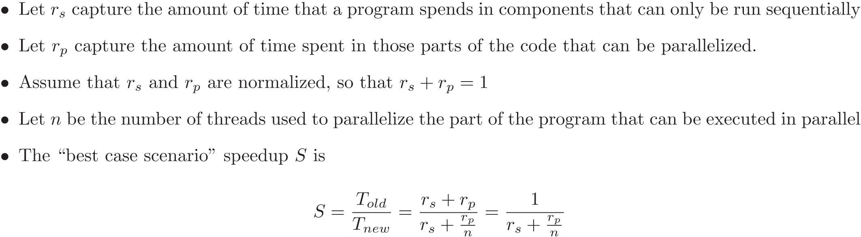
[New Topic] Amdahl's Law
“A fairly obvious conclusion which can be drawn at this point is that the effort expended on achieving high parallel processing rates is wasted unless it is accompanied by achievements in sequential processing rates of very nearly the same magnitude”
“Validity of the single processor approach to achieving large scale computing capabilities,” by Gene M. Amdahl, in Proceedings of the “AFIPS Spring Joint Computer Conference,” pp. 483, 1967
Notes:
How do you know if it makes sense or not to parallelize a piece of code?
What should you expect (in terms of speedup)?

Slide 33
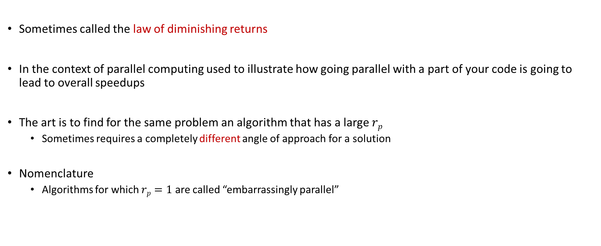
Amdahl’s Law
Sometimes called the law of diminishing returns
In the context of parallel computing used to illustrate how going parallel with a part of your code is going to lead to overall speedups
The art is to find for the same problem an algorithm that has a large $rp$
Sometimes requires a completely different angle of approach for a solution
Nomenclature
Algorithms for which $rp=1$ are called “embarrassingly parallel”

Slide 34
Example: Amdahl's Law
Suppose that a program spends 60% of its time in I/O operations, pre and post-processing
The rest of 40% is spent on computation, most of which can be parallelized
Assume that you buy a multicore chip and can throw 6 parallel threads at this problem.
What is the maximum amount of speedup that you can expect given this investment?
Asymptotically, what is the maximum speedup that you can ever hope for?
Notes:
Answer: 1.5X
(60 + 40)/(60 + 40/6)
Asymptotically: 100/60 = 5/3=1.666 X

Slide 35
Trivia
Gene Amdahl (1922-2015)
Graduated from UW-Madison
1952 PhD, Mathematics and Physics
Amdahl’s law (1967)

Slide 36
GPU Computing with CUDA

Slide 37
The long view
Goal: Understand how GPUs can be used in Scientific Computing
Topics
Hardware considerations
“Hello World” with GPU computing
Execution configuration issues
The memory model in CUDA
Scheduling issues in CUDA
Occupancy and optimization issues
Notes:
It’s fast for a variety of jobs Really good for data parallelism (another way of saying SIMD)
It’s cheap to get one ($120 to $480) High end GPUs for Scientific Computing are more like $7000
GPUs are everywhere Chances are you have one or at least have easy access to one

Slide 38
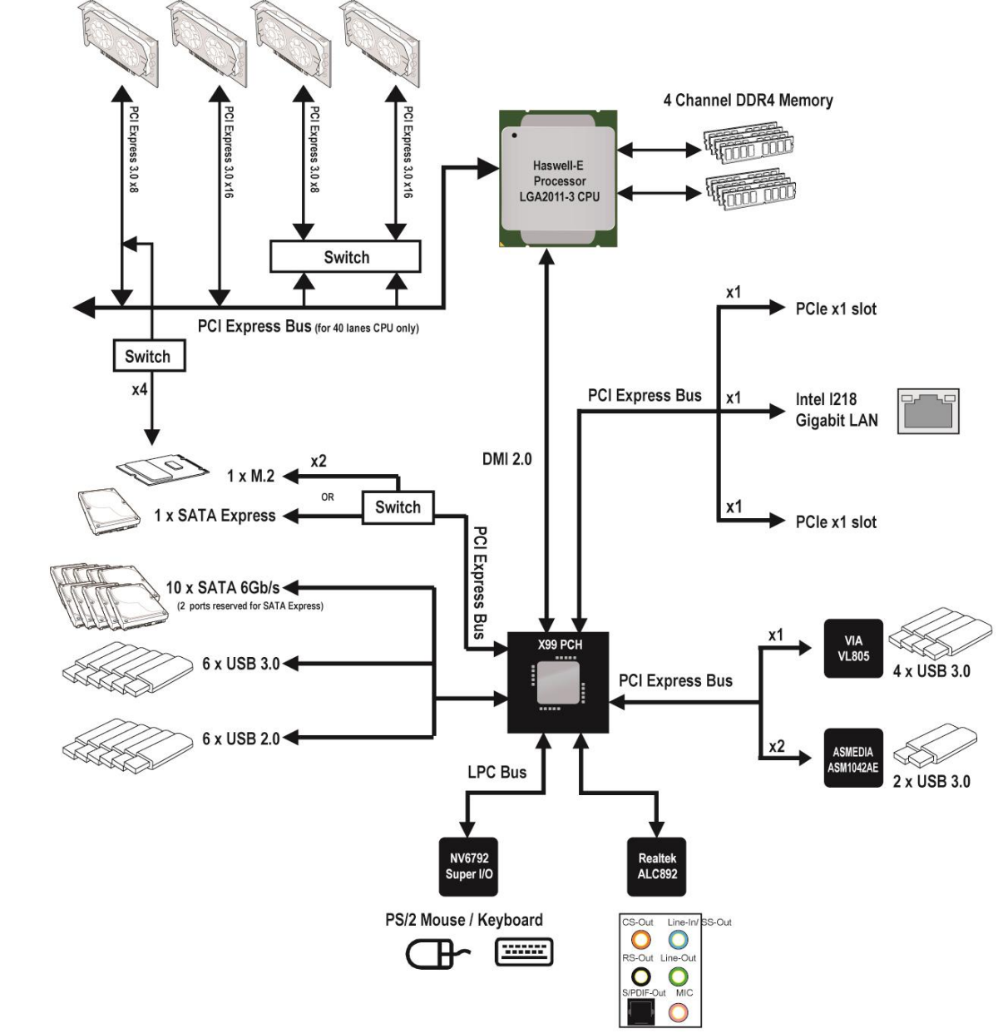
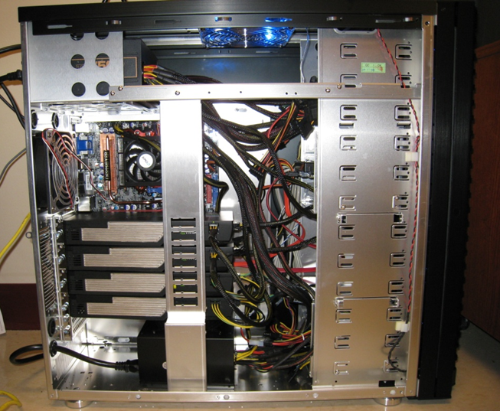

Typical Hardware Architecture
GPU w/ local DRAM
(the “device”)
CPU
(the “host”)
[http://www.anandtech.com]$→$
Notes:
The bridge now absorbed in CPU (the chipset).
GPUs also called accelerators or co-processors (complement the CPU).
The GPU connected through the PCIe bus
In PCIe 1.1 (currently the most common version) each lane sends information at a rate of 250 MB/s (250 million bytes per second) in each direction. PCIe 2.0 doubles this data rate, introduced in late 2007, PCIe 2.0 is found on newer systems such as those based around the Intel X38 or AMD 780G chipsets. The latest proposed PCIe 3.0 standard will increase the speed of the links further (tentatively scheduled for release around 2010).[1]
Each PCIe slot carries either one, two, four, eight, sixteen or thirty-two lanes of data between the motherboard and the addin card. Lane counts are written with an "x" prefix e.g. x1 for a single-lane card and x16 for a sixteen-lane card. Thirty-two lanes of 250 MB/s (PCIe 1.1) gives a maximum transfer rate of 8 GB/s (250 MB/s x 32, i.e., 8 billion bytes per second) in each direction. However the largest size in common use for PCIe 1.1 is x16, giving a transfer rate of 4 GB/s (250 MB/s x 16) in each direction. Putting this into perspective, a single lane for PCIe 1.1 has nearly twice the data rate of normal PCI, a four-lane slot has a transfer rate comparable to the fastest version of the old parallel PCI-X 1.0, and an eight-lane slot has a transfer rate comparable to the fastest version of AGP. However the data rates cited must be derated because 8b/10b coding is used in the physical layer. The link transfer speeds cited are to be considered maximum theoretical data rates.
PCIe slots come in a variety of physically different sizes referred to by the maximum lane count they support, ie. x1, x2, x4, x8, x16 and x32. A PCIe card will fit into a slot of its size or bigger, but not into a smaller PCIe slot.

Slide 39
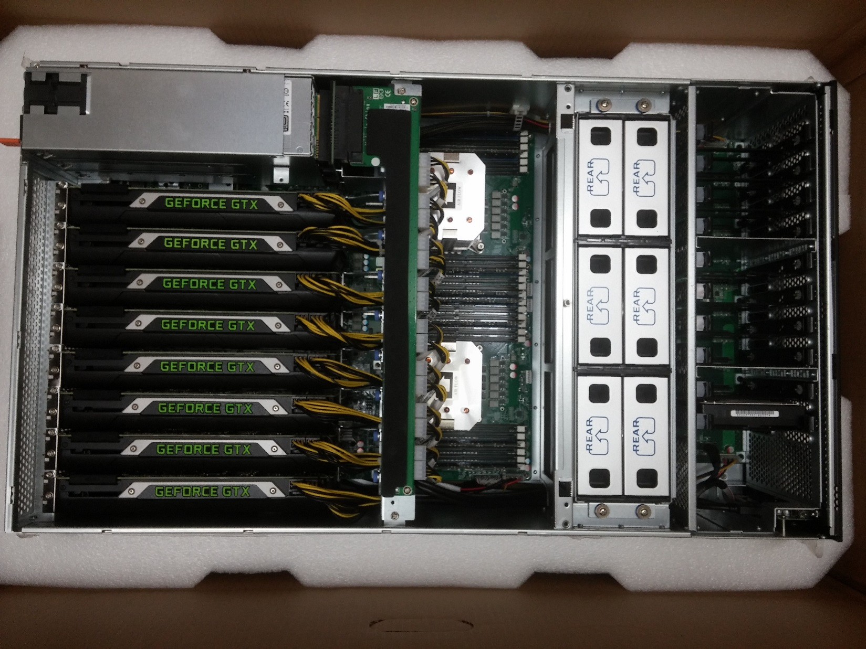
Euler Node, 2015 Vintage

Slide 40
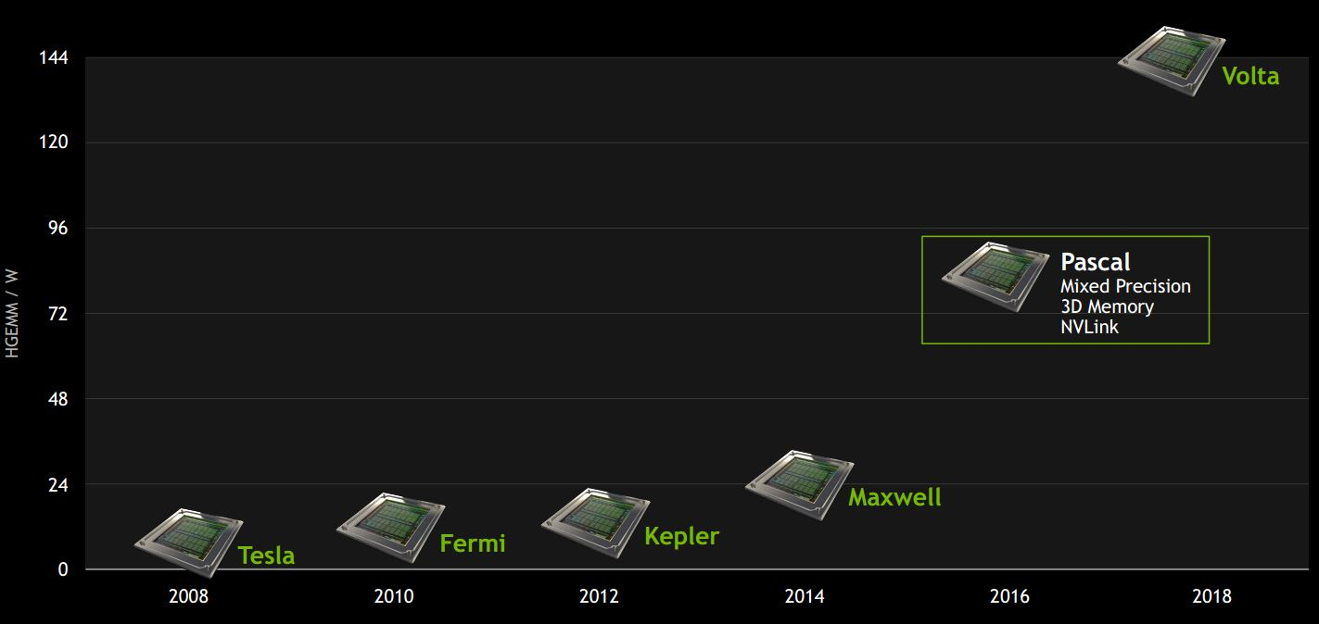
NVIDIA GPU Evolution [relative to dense matrix-matrix multiplication performance per Watt]
Slightly dated plot, doesn’t show Ampere architecture
Notes:
Next (2018): Volta

Slide 41
GPU computing: eager to accommodate Machine Learning needs

Slide 42
Fermi: High-level Perspective
Lots of ALU (green), not much of CU (orange)
Explains why GPUs are fast for high arithmetic intensity applications
Arithmetic intensity: high when many operations performed per word of memory access
Notes:
How else could you organize 3 billion (today 7 billion) transistors?
Specialize the hardware. Organize it into a bunch of Streaming Multiprocessors and dedicate most transistors to number crunching (ALUs)

Slide 43
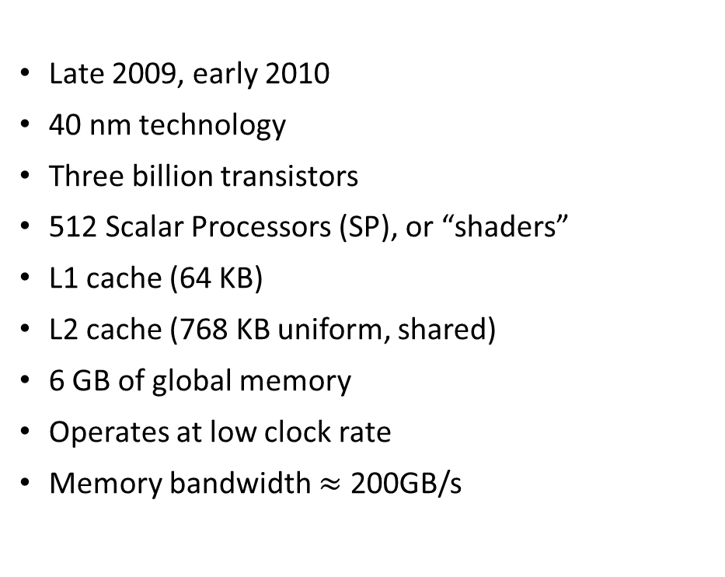
The Fermi Architecture: The Stream Multiprocessor (SM)
Late 2009, early 2010
40 nm technology
Three billion transistors
512 Scalar Processors (SP), or “shaders”
L1 cache (64 KB)
L2 cache (768 KB uniform, shared)
6 GB of global memory
Operates at low clock rate
Memory bandwidth $≈$ 200GB/s
The “Stream Multiprocessor”
Notes:
An SM is the quantum of scalability on a GPU. More $ → more SMs
Think of an SM as a single core on a CPU (do not buy into NVIDIA’s marketing)
Why is this important? Think of launching a job with 1 million threads. The more SMs you have, the more SPs…
512= 16 x 32
Components:
16+16 = 32 SPs
16 load/store units
4 SFU (for special functions)
2 warp schedulers
Several clock rates:
Shaders (SPs)
Scheduler: ½ the frequency of the SPs
Memory: own rate

Slide 44
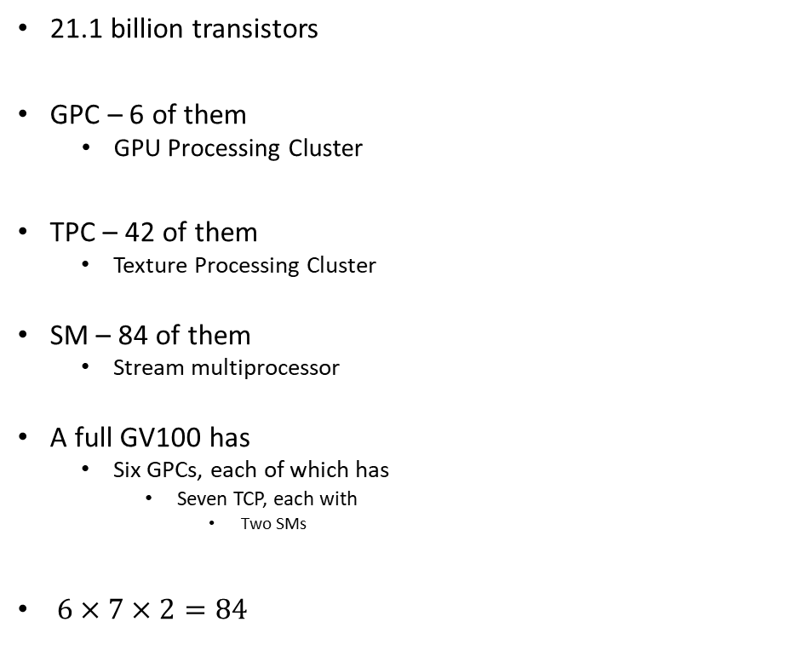
NVIDIA Volta GV100: microarchitecture schematic and nomenclature
21.1 billion transistors
GPC – 6 of them
GPU Processing Cluster
TPC – 42 of them
Texture Processing Cluster
SM – 84 of them
Stream multiprocessor
A full GV100 has
Six GPCs, each of which has
Seven TCP, each with
Two SMs
$6×7×2=84$
Notes:
A full GV100 GPU has a total of:
5376 FP32 cores
5376 INT32 cores
2688 FP64 cores
672 Tensor Cores
336 texture units

Slide 45

NVIDIA Volta GV100: microarchitecture schematic and nomenclature
Each SM has
64 FP32 scalar processors (SPs)
64 INT32 scalar processors (SPs)
32 FP64 scalar processors (SPs)
8 Tensor scalar processors (SPs)
Four texture units
It’s own L0 Instruction Cache
A wrap scheduler
A Dispatch unit
16,384 registers
[NVIDIA]$→$

Slide 46
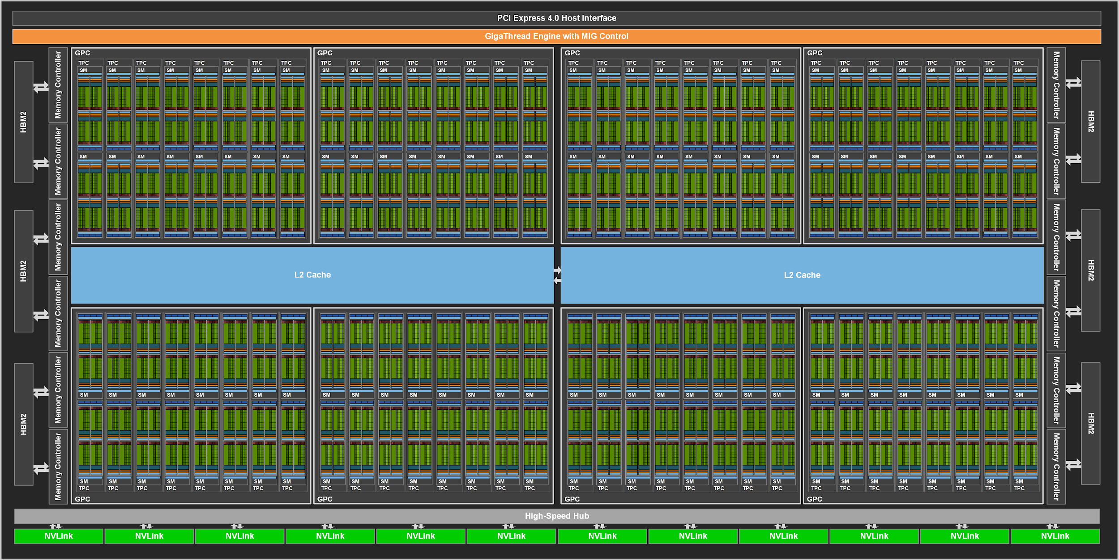
Ampere A100
[https://developer.nvidia.com/blog/nvidia-ampere-architecture-in-depth/]$→$

Slide 47
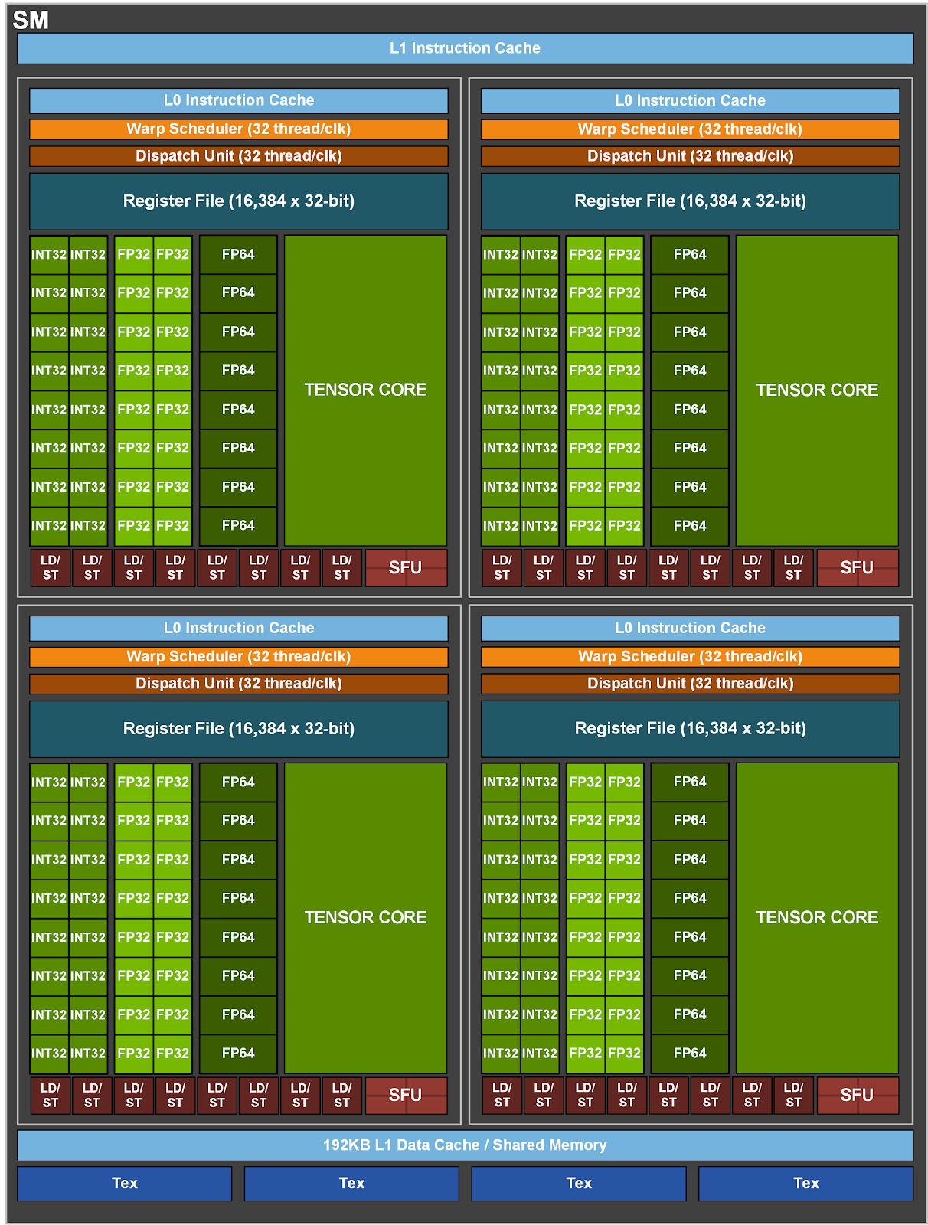
NVIDIA Ampere GA100: microarchitecture schematic & nomenclature [1/2]
Each SM partitioned into four processing blocks, called SM sub-partitions
Each sub-partition contains the following:
Warp scheduler
Register file
Functional units
Integer Execution units
Floating Point Execution units
Memory Load/Store units
Special Function unit
Tensor Cores
[NVIDIA]$→$

Slide 48
NVIDIA Ampere GA100: microarchitecture schematic & nomenclature [2/2]
There are several things shared amongst the four sub-partitions
Unified L1 Data Cache / Shared Memory
Texture units
RT Cores, if available (RT: ray tracing)
[NVIDIA]$→$

Slide 49


Performance overview, last four NVIDIA GPU generations
This is what more transistors buys you $→$
[NVIDIA]$→$

Slide 50
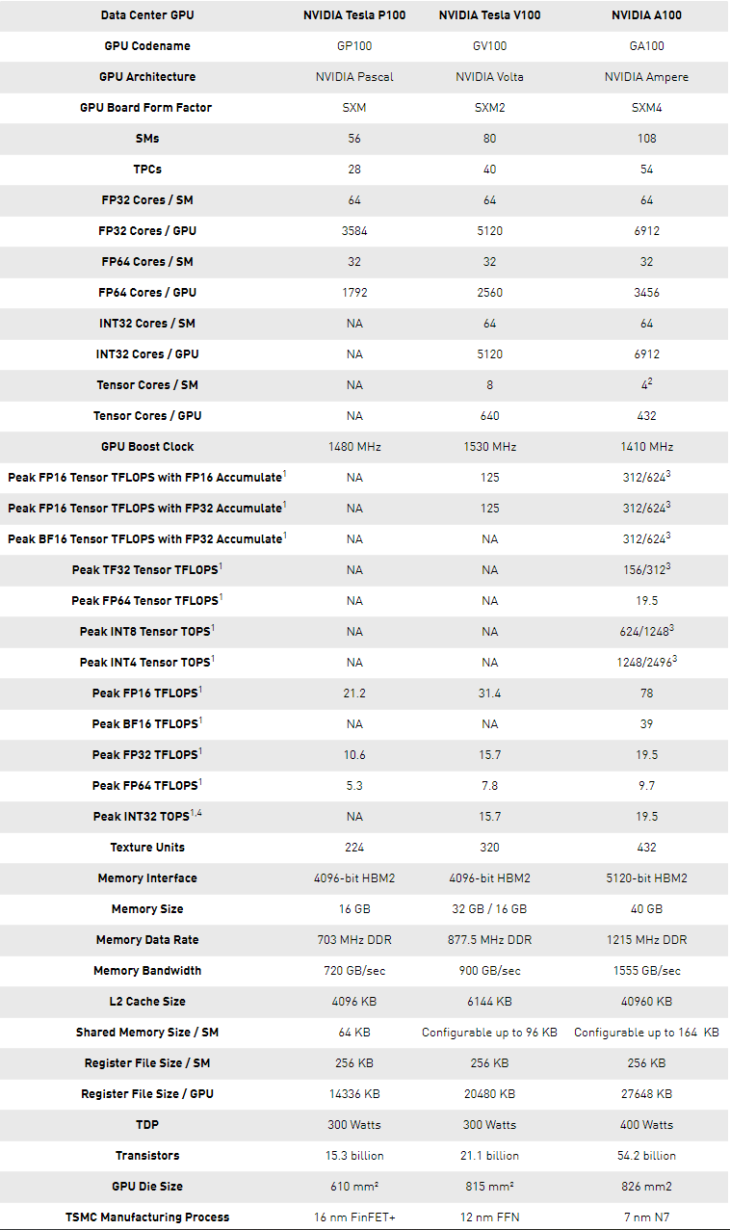
[https://developer.nvidia.com/blog/nvidia-ampere-architecture-in-depth/]$→$

Slide 51
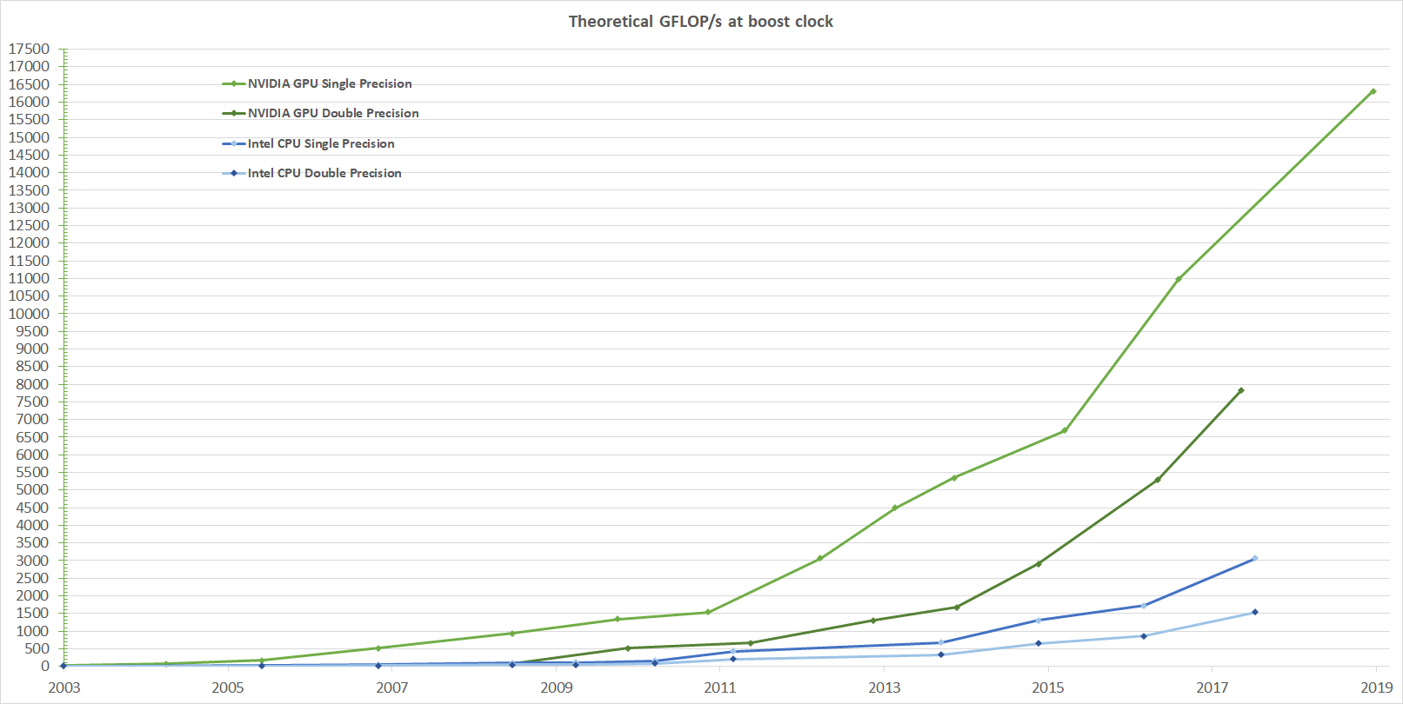
Theoretical GFLOP/s
[NVIDIA]$→$
Notes:
Xeon E7-8800 v4: 0.844 TFLOPS

Slide 52
High Speed Requires High Bandwidth
Assume that you want to add two arrays and reach 1 Tflops: 1E12 ops/second
You need to fetch/feed 2E12 operands per second…
Assume each number is stored using 4 bytes (float or integer)
You need to fetch 2E12*4 bytes in a second. This is 8E12 B/s, which is 8 TB/s…
You haven’t taken into account that you probably want to send back the outcome of the operation that you carry out
Today’s global memory bandwidth on the GPU: 1.555 TB/s
Notes:
The solution is to keep data in registers (more about this later)
The bandwidth of accessing data from registers is exactly around 8 TB/s.
Here’s a set of rules that you need to keep in mind before going further…
Get the data on the GPU and keep it there
Give the GPU enough work to do (High arithmetic intensity)
Focus on data reuse within the GPU to avoid memory bandwidth limitations

Slide 53
Bandwidth in a CPU-GPU System
Latency:
Very Low
GPU SMs
CPU Core
Cache L1: 32 KB
L2: 256 KB
L3: 45 MB (shared)
BW:???
NOTE: The width of the black lines is proportional to the bandwidth.
120
GB/s
1555
GB/s
Latency:
Medium Low
Latency:
Rel.Low
System Memory
(256 GB)
GPU Memory
(40 GB)
Infiniband to Next Node
16-32 GB/s
6GB/s
Latency:
High
[4-6 us]
Latency:
Medium
53
Notes:
53
Hammad – GPU numbers are for a Pascal P100, PCI numbers are for PCIe3
Infiniband is assuming mellanox results from here: http://www.mellanox.com/page/performance_infiniband
CPU memory numbers are for a E7 8890v3 http://ark.intel.com/products/84685/Intel-Xeon-Processor-E7-8890-v3-45M-Cache-2_50-GHz
CPU cache numbers are an average between expected L1 and L3 cache performance (not exact but approximate)

Slide 54
Info on Previous Slide
GPU numbers are for an NVIDIA Ampere A100
PCI numbers are for PCIe3 (16 GB/s) or PCIe4 (32 GB/s)
Infiniband is assuming Mellanox results from here
CPU memory numbers are for a E7 8890v3, 2.5GHz, 45MB L3
CPU cache numbers: depends highly on cache level
In theory, can be 1000 GB/s (again, depending on cache level)
Question, for “good answer” badge: why is the BW in the memory mountain experiment so low, if caches are warm?

Slide 55
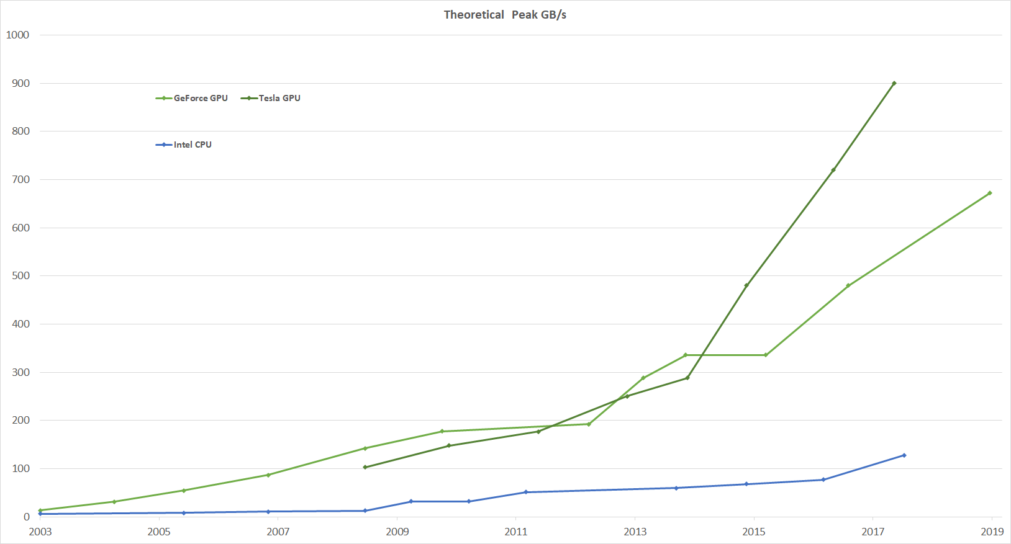
Bandwidths, GPU computing w/ NVIDIA
[NVIDIA]$→$
Notes:
If you look at flop rates GPU/CPU, also about 5 (roughly like the bandwidth ratio)
Take away message: you can expect a speedup of 2-10 if moving to GPU. Do not expect 100x
Tesla P100 (Pascal): 720 GB/s (stacked memory) → short detour

Slide 56
Speed-ups, GPU Computing: What’s reasonable to expect?
Since you have higher bandwidth on a GPU, it is likely that your code will run faster on the right problem
How much faster?
Compare the bandwidth/latency of mem accesses on GPU and CPU
Ball park: 4-5X speedup
Depends *heavily* on the nature of the problem solved: ML jobs sped up by a lot more
Other things might come into play
Caches and cache size, for instance
The very nature of the problem you’re trying to solve
Good for data parallelism, fine grain parallelism

